Slide 1
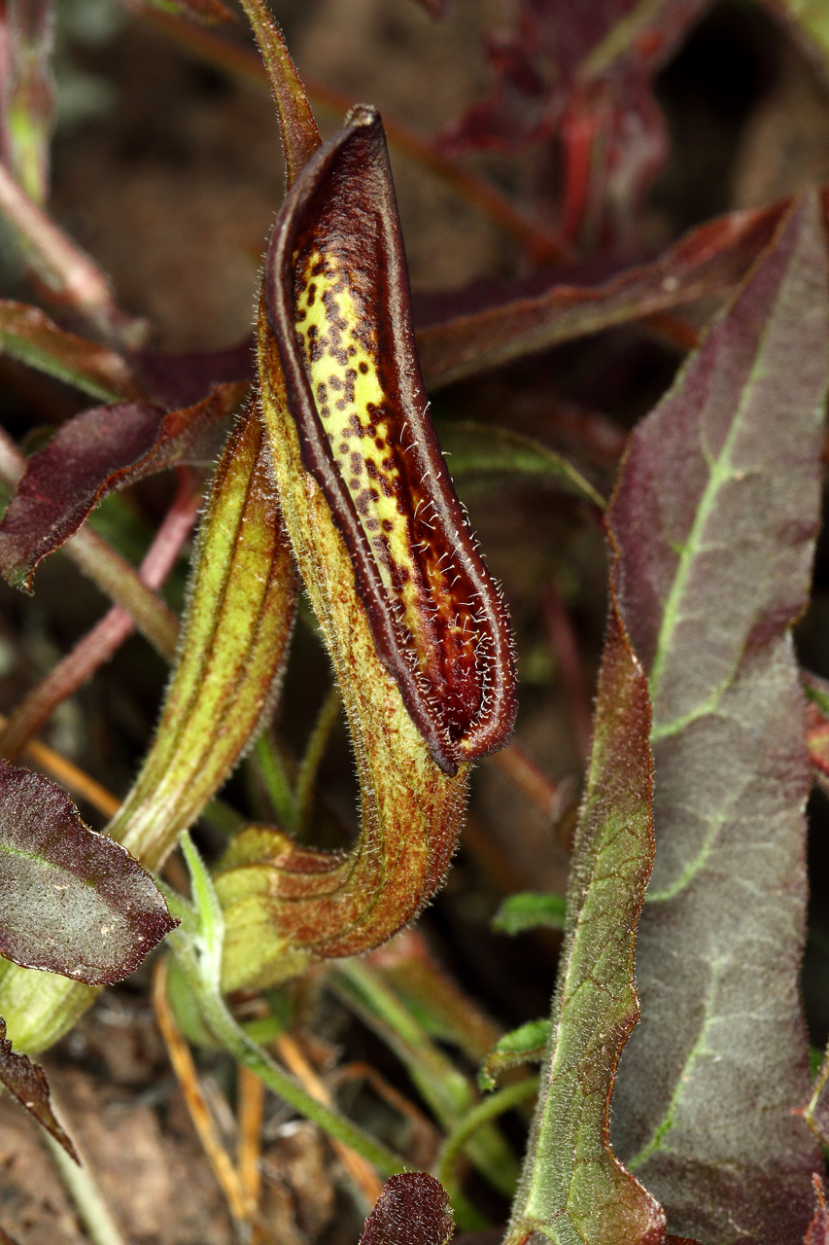

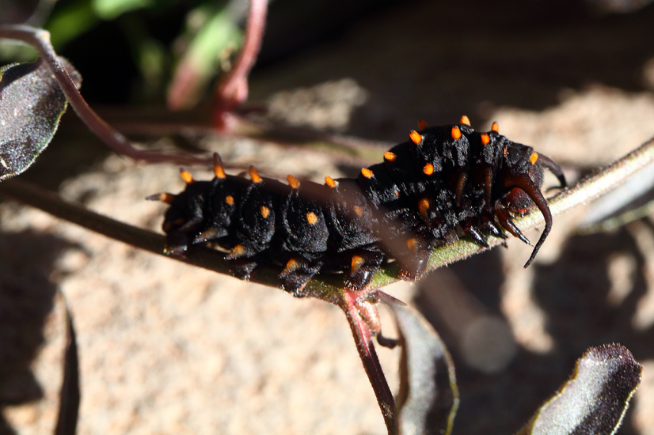
Plant Taxonomy
Russ Kleinman
575-574-8454

Slide 2
I’ll go first…
I am a retired board certified general surgeon with nearly 30 years of surgical experience in Albuquerque, Cincinnati and Silver City.
There is a long tradition of physician botanists in New Mexico.
This is the 9th time I have taught this class– please ask questions and keep me honest!

Slide 3
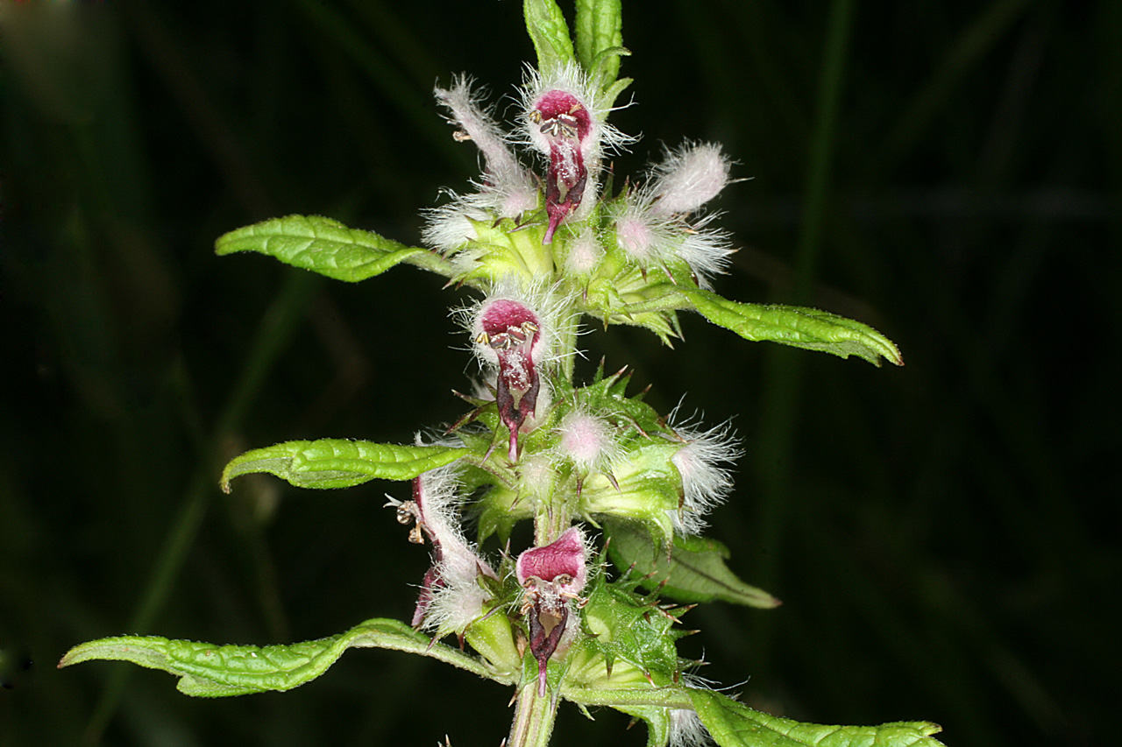
Now, you…

Slide 4
Botany regarding classwork and reading…
--Berton Braley
Science News Letter
March 9, 1929

Slide 5
There should be no monotony
In studying your botany;
It helps to train
And spur the brain--
Unless you haven't gotany.

Slide 6
It teaches you, does Botany,
To know the plants and spotany,
And learn just why
They live or die--
In case you plant or potany.

Slide 7
You learn, from reading Botany,
Of wooly plants and cottony
That grow on earth,
And what they're worth,
And why some spots have notany.

Slide 8
You sketch the plants in Botany,
You learn to chart and plotany
Like corn or oats--
You jot down notes,
If you know how to jotany.

Slide 9
Your time, if you'll allotany,
Will teach you how and what any
Old plant or tree
Can do or be--
And that's the use of Botany!
.

Slide 10
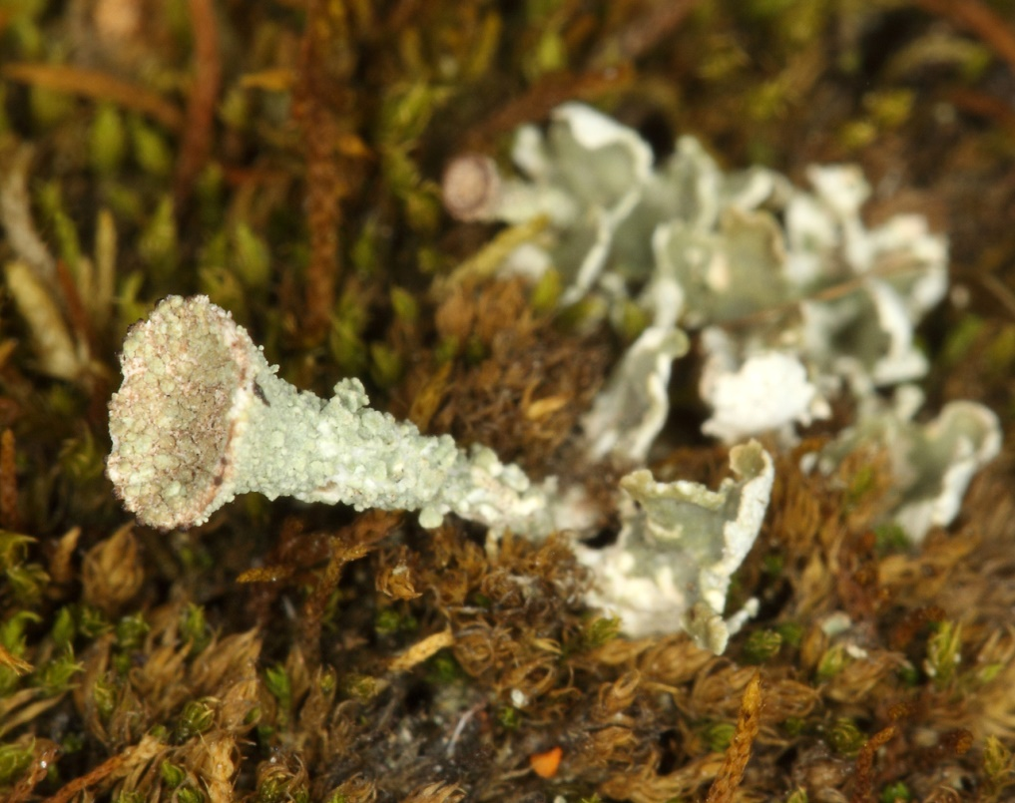
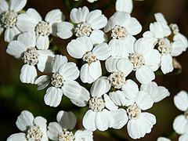
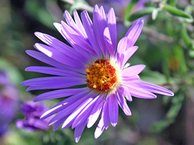
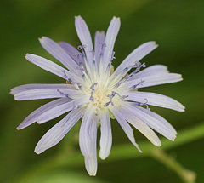
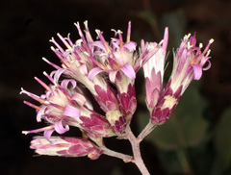
Plant Taxonomy
What’s a Plant?
What’s Taxonomy?
?
?

Slide 11
How to Do Well In Plant Tax!
Get Judd & Campbell’s “Plant Systematics” 4th edition and keep up with the reading.
Start your plant collection early and don’t depend on finishing your collection in November when the plants no longer have reproductive parts→ they won’t be accepted if they don’t have flowers or fruit.
Again…ask questions, keep me honest.

Slide 12
Plant Collection Info
A poem by Charles Edward Carryl, entitled “Robinson Crusoe’s Story” 6th verse, reads:
“Then we gather as we travel,
Bits of moss and dirty gravel,
And we chip off little specimens of stone;
And we carry home as prizes
Funny bugs, of handy sizes,
Just to give the day a scientific tone.”

Slide 13
This is our written permission to collect in the forest– note the restrictions.

Slide 14
You MUST keep a detailed Field Book!
(which will be graded along with your plant collection)
Why?– info there becomes priceless– where you collected the specimen and when. What color was the flower, realizing that flower color can change dramatically when a plant is dried and pressed.
Macroptilium gibbosifolium example.
Need to record location info: Nearest town, Ponderosa forest or desert, PJ woodland, etc.
These days, you also need GPS coordinates.

Slide 15
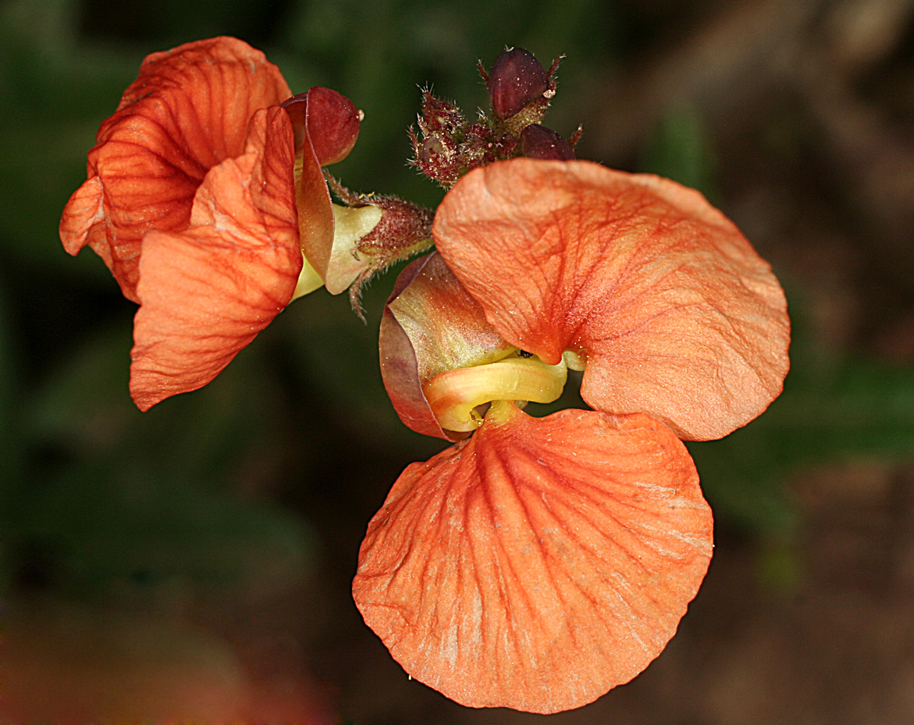
Macroptilium gibbosifolium

Slide 16
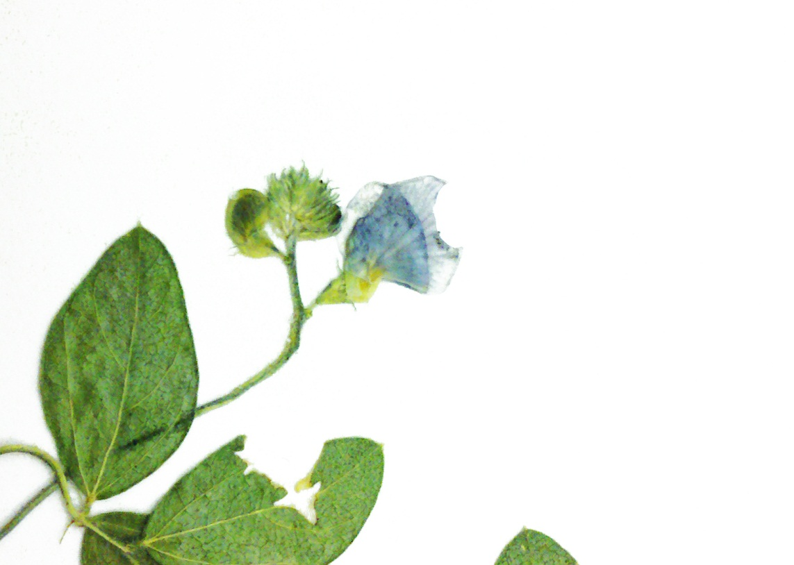
Macroptilium gibbosifolium
Dried and Pressed flower

Slide 17
More Clues to Success
Do NOT collect threatened or endangered species from the forest– it is against the terms of our agreement with the Forest Service
I will show you how to make the labels, they have to be EXACTLY how the curator of the herbarium (Dr. Norris) wants them
Don’t miss the lab field trips– there is too much to learn to all be taught in lecture.

Slide 18
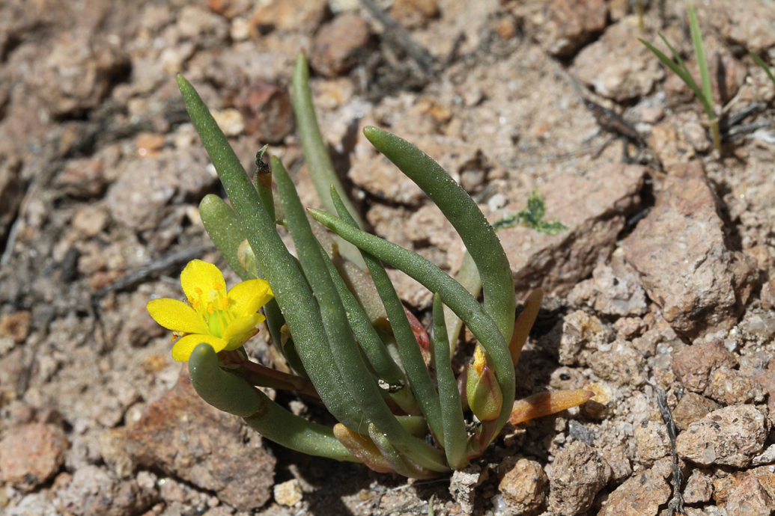
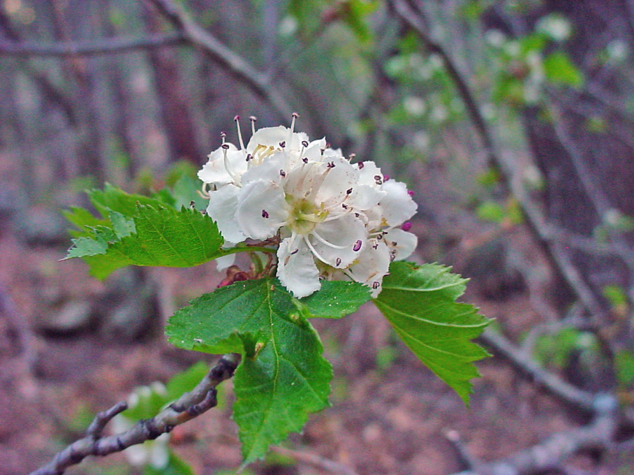
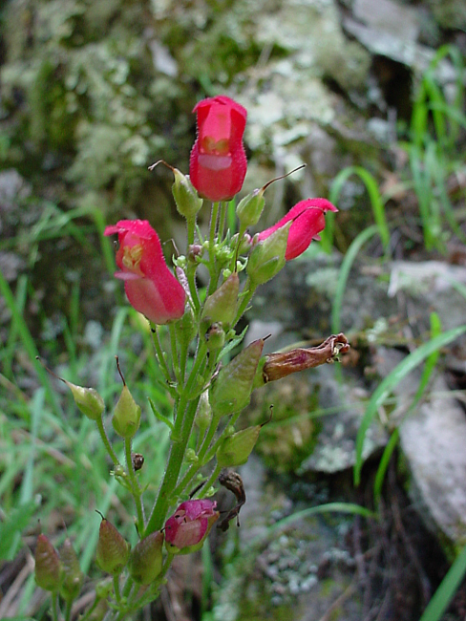
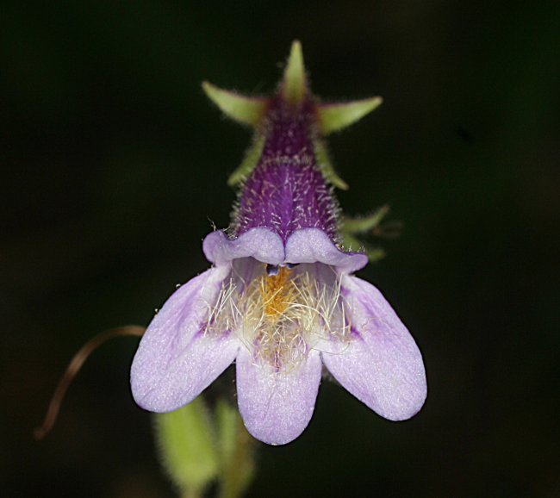
You May Not Collect State Listed Species
Phemeranthus humilis
Craetagus wootoniana
Scrophularia macrantha
Penstemon metcalfii

Slide 19
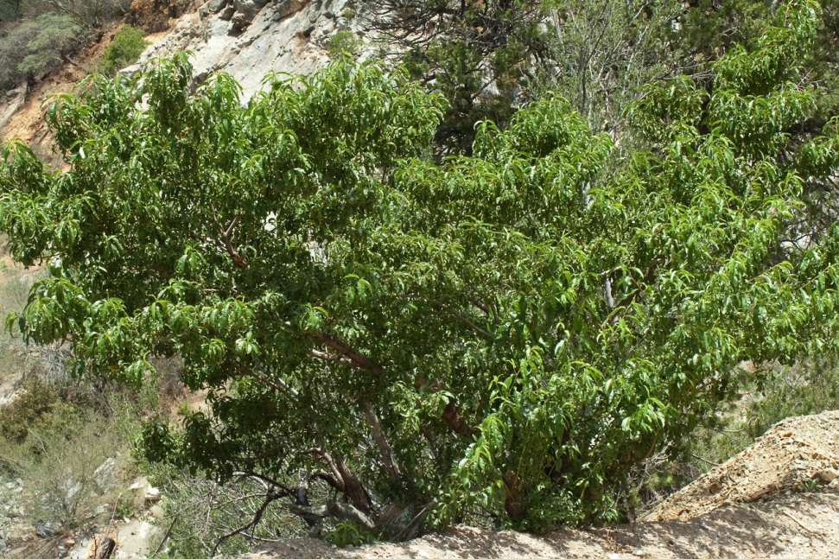
Other Things NOT to Collect…
No peach trees…

Slide 20
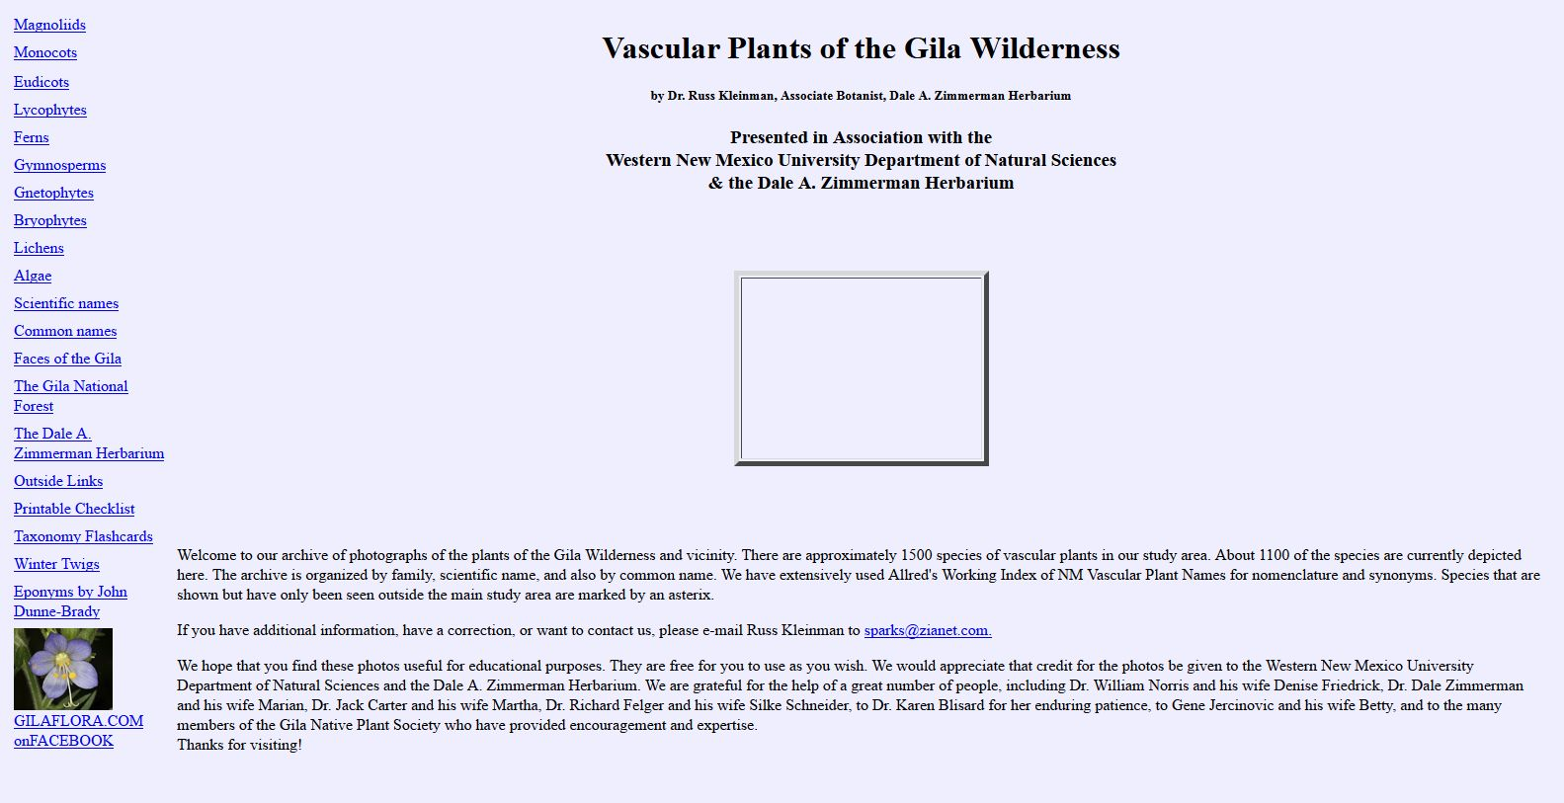
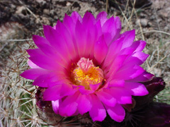
gilaflora.com

Slide 21
See you Wednesday!
We’ll dive into the principles of Plant Systematics.
Expect lots of new vocabulary.
I strongly recommend you read the J&C assignment before getting to class.
J&C pp. 1-11 and 13-26

